Slide 1

NutriWeb
Eat Better, Feel Better, Do Better
What if every bite you took could align with your health, values, and the planet? NutriWeb empowers you to make informed food choices with personalized recommendations, transparent insights, and a focus on sustainability.
-By Thanvitha Munagala and Pavan Venigalla

Slide 2

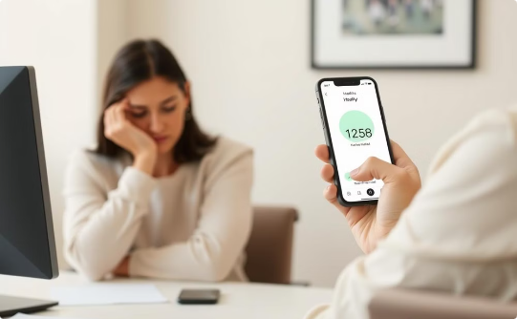
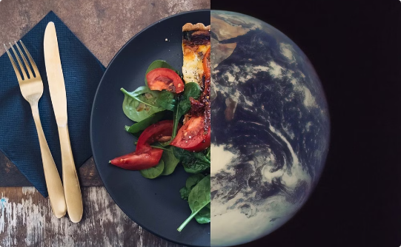
The Problem: Existing Apps Fall Short
Confusing Information
Lack of Personalization
Sustainability Blind Spot
Complex labels and unclear summaries make it hard to understand ingredients.
Generic scores don't account for individual needs like allergies or BMI.
Most apps ignore the environmental impact of food choices.

Slide 3
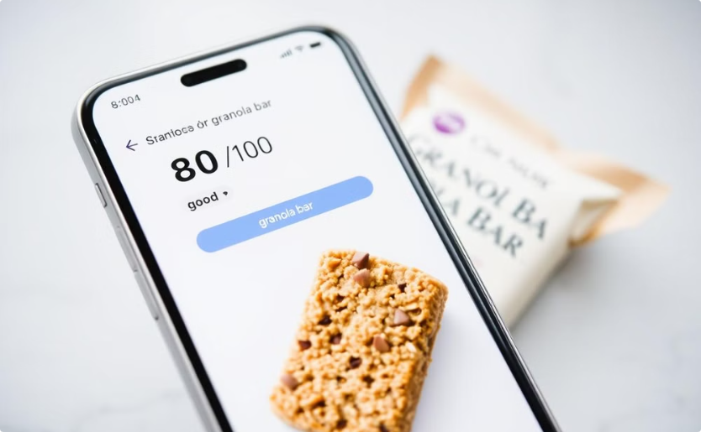
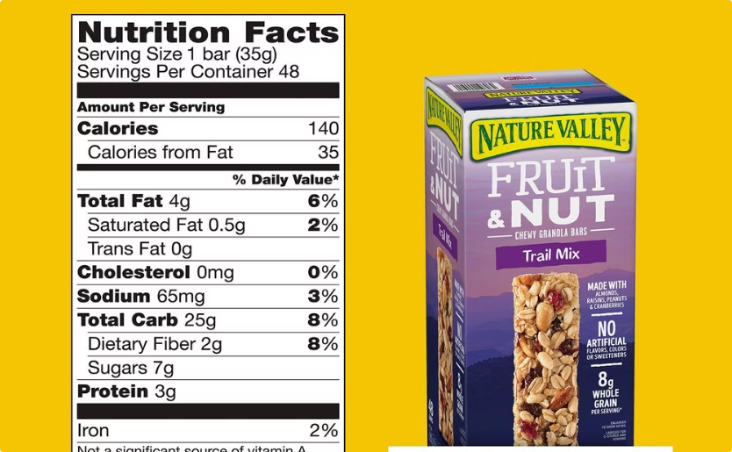
The Solution: NutriWeb in Action
Other App
NutriWeb
Other apps says this granola is "good" (score 80/100), but doesn't highlight high sugar content.
NutriWeb flags high sugar, suggests healthier alternatives, and shows the product's eco-impact.

Slide 4
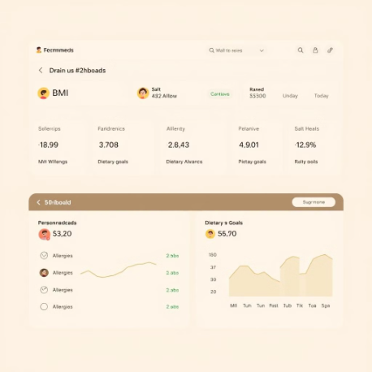
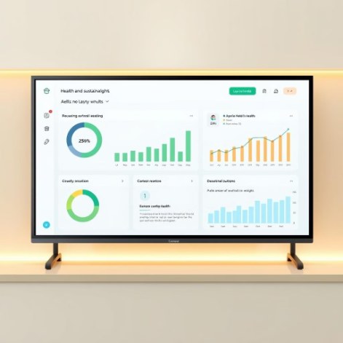
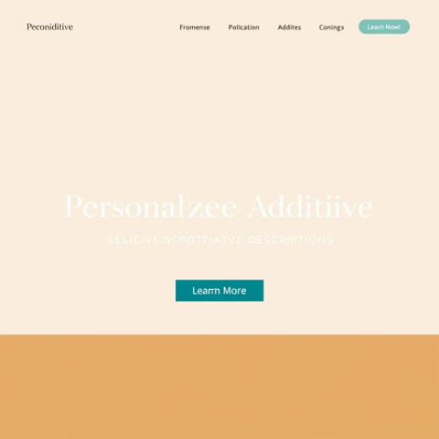
Key Features That Delight Users
Personalized for You
Transparency You Can Trust
Context-Aware Additives
Tailored recommendations based on BMI, allergies, and dietary goals.
Users can compare multiple products visually (e.g., pie charts) to make informed choices.
NutriWeb provides nuanced descriptions of additives based on individual needs.

Slide 5
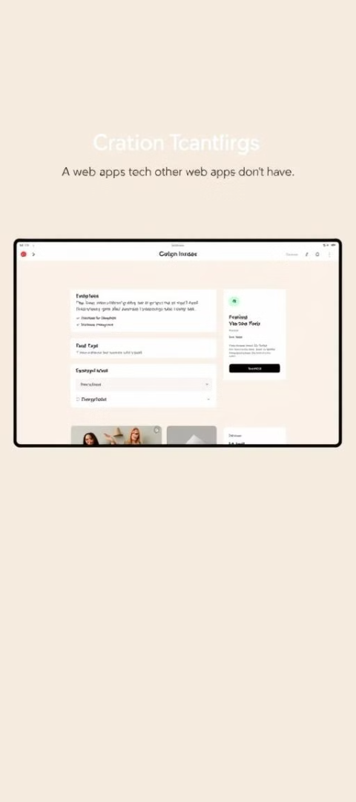
Why NutriWeb Wins vs. App
Feature
NutriWeb
Other App
Personalization
✅BMI, allergies, goals
❌Generic scores
Sustainability
✅ Carbon footprint tracker
❌None
Transparency
✅Visual dashboards
❌Text-only summaries
Social Impact
✅Encourages eco-friendly and health-conscious choices.
❌None

Slide 6



Info about Datasets
Nutritional & Product Data
Health & Demographic Data
Non-GMO Project Verified Database
Open Food Facts
NHANES (National Health and Nutrition Examination Survey)
What: A crowdsourced database of 3M+ global food products (barcodes, ingredients, allergens, eco-labels).
Non-GMO Project org
What: U.S. population health data (age, weight, BMI, dietary habits).
What: Certified non-GMO products (60k+ items).
Use Case: Flag GMO ingredients (e.g., "Contains GMO soy").
Use Case: Match scanned products to ingredients and nutritional facts.
Use Case: Train models to link BMI/demographics to food preferences.

Slide 7
Building the Future of Food Choices
1
Data Exploration & Cleaning
Clean and preprocess product data for model development extract and categorize key information using NLP.
2
Model Development
Leverage NLP libraries (SpaCy, NLTK, Hugging Face) to extract and categorize key information and data visualization tools (Plotly, Matplotlib) to extract key insights from data
3
User Database Creation
Create user profiles (weight, height, BMI, preferences, allergens) and store them in a database (PostgreSQL or MongoDB).
4
Deployment
Deploy the web application using Streamlit/Heroku, integrate the app with the database and recommendation engine.

Slide 8


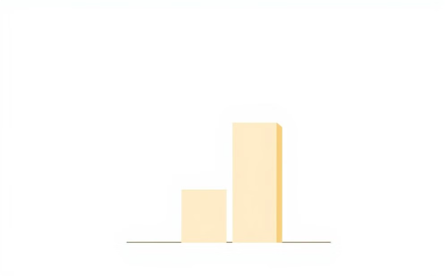
Real-World Impact
User Testimonials
User Testimonials
Planet Impact
"Lost 20 lbs by avoiding hidden sugars!"
"Found allergy-safe snacks easily!"
10K users save 50,000 kg CO₂ monthly!

Slide 9




The Roadmap: What's Next?
Wearable Integration
Recipe Suggestions
Sync with fitness trackers to personalize recommendations based on activity levels and calorie burn.
Provide recipes based on recommended products to inspire healthy and delicious meals.
Gamification
AR Supermarket Scanner
Reward users for making healthy and sustainable choices, fostering positive engagement.
Use your phone camera to instantly see NutriWeb ratings for products in the supermarket.

